Slide 1
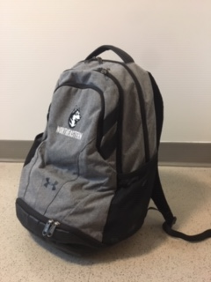
The backpack
Historical development
Affordances
Constraints

Slide 2
Historical development

Slide 3
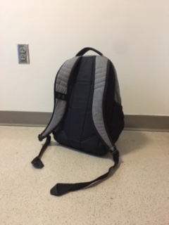
Affordances
- visible affordances
- hidden affordances

Slide 4
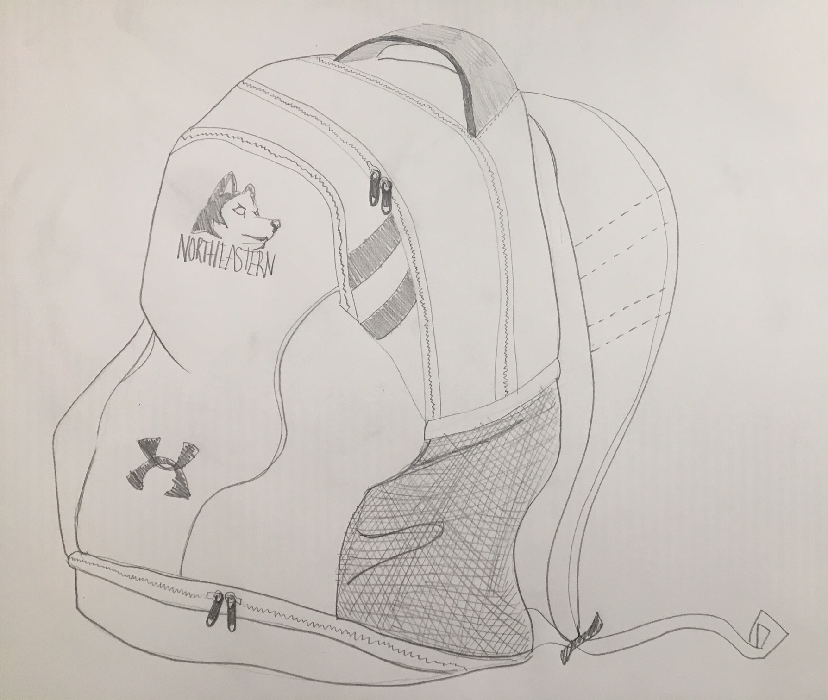
Constraints
- physical constraints
- materialistic constraints
- cultural constraints

